Slide 1

Chapter 8
Kinship and Domestic Life

Slide 2
Learning Objectives
8.1 Define the three ways cultures create kinship.
8.2 Recognize how anthropologists define and study households and domestic life.
8.3 Illustrate how kinship and households are changing.

Slide 3
Kinship and Domestic Life
What is kinship?
  Sense of being related to another person(s)
  Set by cultural rules (sometimes laws)
  Often taken for granted as being “natural” rather than cultural
  Links with all aspects of culture
  Not all cultures define kinship on the basis of “blood”
    Example: Tory Islanders
Kinship system:
  The predominant form of kin relationships in a culture and the kind of behavior involved

Slide 4
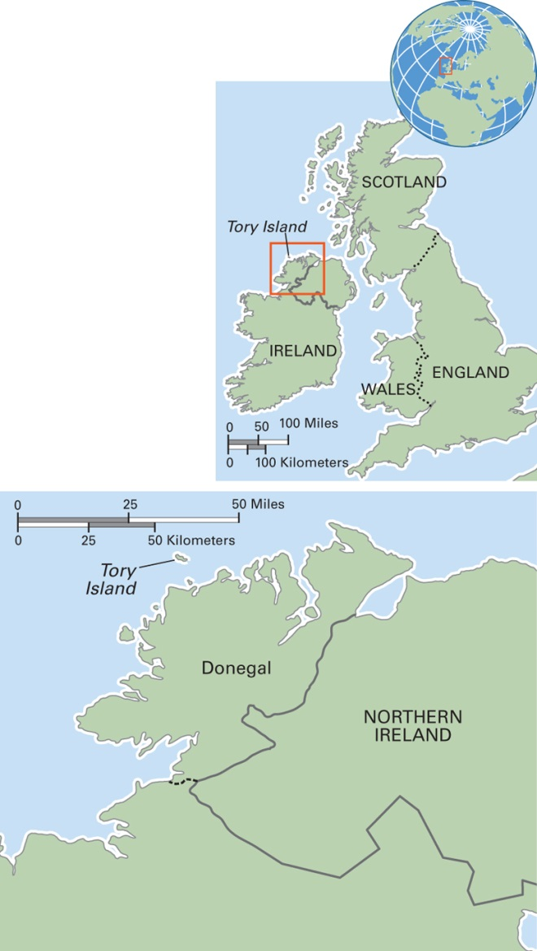
Map 8.1 Ireland
Notes:
The Republic of Ireland’s population is 4.6 million. The geography is low central plains surrounded by a ring of mountains. Membership in the European Union (EU) and the rising standard of living earned Ireland the nickname of the Celtic Tiger. Its economic opportunities attracted immigrants from places as diverse as Romania, China, and Nigeria. The financial crisis that began in 2008 has had major negative effects on the economy. Most people are Roman Catholics, followed by the Anglican Church of Ireland.

Slide 5
How Cultures Create Kinship
8.1 Define the three ways cultures create kinship.
Studying Kinship: From Formal Analysis to Kinship in Action
Descent
Sharing
Marriage

Slide 6
Studying Kinship: From Formal Analysis to Kinship in Action (1 of 2)
Anthropologists collected data on kinship terms and relationships around the world
  Created categories, or types of kinship systems with similar features, named after a particular culture, such as “Eskimo” or “Iroquois” kinship
  These categories are no longer in prominent use by anthropologists
Kinship diagrams used as a descriptive and analytical tool

Slide 7
Studying Kinship: From Formal Analysis to Kinship in Action (2 of 2)
Two classic kinship types:
  Eskimo: Similar to most Euro-Americans. Has unique terms for kin within the nuclear household; same terms for relatives on mother’s and father’s sides
  Iroquois: Different terms for relatives on mother’s and father’s sides; merges mother and mother’s sisters

Slide 8
Descent (1 of 4)
Kinship created through birth into a particular group
Two major types:
  Unilineal
  Bilineal

Slide 9
Descent (2 of 4)
Unilineal descent
  Basis of kinship in 60 percent of the world’s cultures
  Most associated with pastoralist, horticultural, and agricultural modes of livelihood
  Two major types of unilineal descent:
    Patrilineal (through the male line)
    Matrilineal (through the female line)

Slide 10
Descent (3 of 4)
Bilineal descent
  Descent is traced equally from both parents
  Married couples live away from their parents (neolocal residence)
  Inheritance is allocated equally among all children regardless of their gender

Slide 11
Descent (4 of 4)
Bilineal descent often found in foraging and industrial/digital cultures
Examples:
  Euro-Americans
  Ju/wasi
  Innu (Inuit)

Slide 12
Think Like an Anthropologist:
What’s in a Name? (1 of 2)
In village of Ha Tsuen, personal naming system reflects importance and power of males
All babies are given a ming
  A boy’s ming is distinctive and flattering
  Girls’ mings often have negative connotations
Ritual importance: A 30-day ceremony is held for all babies, but the ceremony for a boy is as elaborate as the family can afford

Slide 13
Think Like an Anthropologist:
What’s in a Name? (2 of 2)
A man is given or chooses tzu (marriage name) and has a wai hao (public nickname)
When a woman marries, her ming ceases to exist
Husband refers to her as nei jen (inner person)
May also be referred to by teknonyms (names based on a person’s relationship to someone else, as in “wife of so and so”)

Slide 14
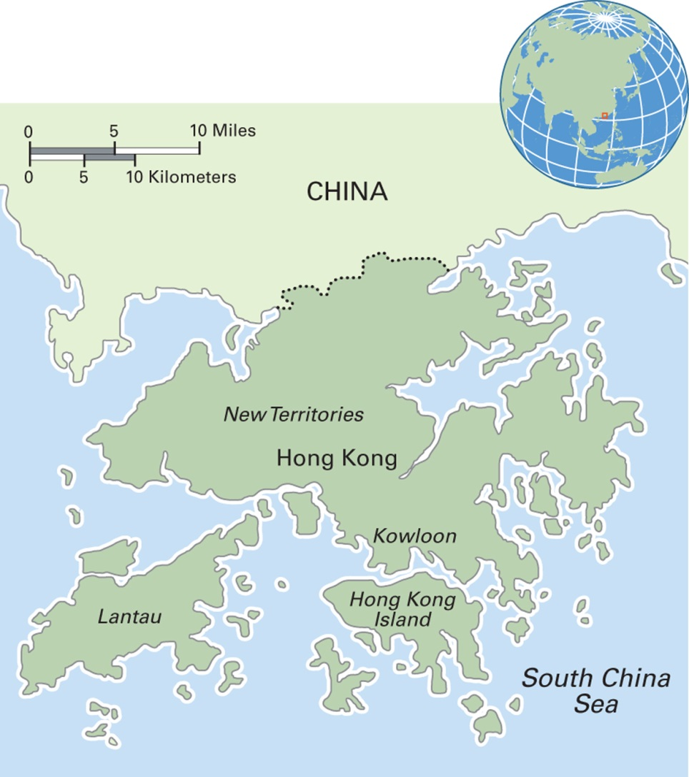
Map 8.2 Hong Kong
Notes:
The formal name of Hong Kong is the Hong Kong Special Administrative Region of the People’s Republic of China. A world center of finance and trade, it lacks natural resources and agricultural land, so it imports most of its food and raw materials. With seven million residents, Hong Kong’s population density is extremely high while its fertility rate, at 1.1, is among the world’s lowest. Most of the population is ethnic Chinese, and many practice ancestor worship. Ten percent of the population is Christian. Religious freedom is protected through Hong Kong’s constitution.

Slide 15
Culturama:
The Minangkabau of Indonesia
World’s largest matrilineal culture
Economy based mainly on rice farming
Some men and women work in cities and then return home
Women hold power through control of lineage land
Sub-matrilineage groups of adult women and girls live together in a lineage house
Men and older boys often live separately
In the household, the senior woman controls the power and makes all decisions

Slide 16
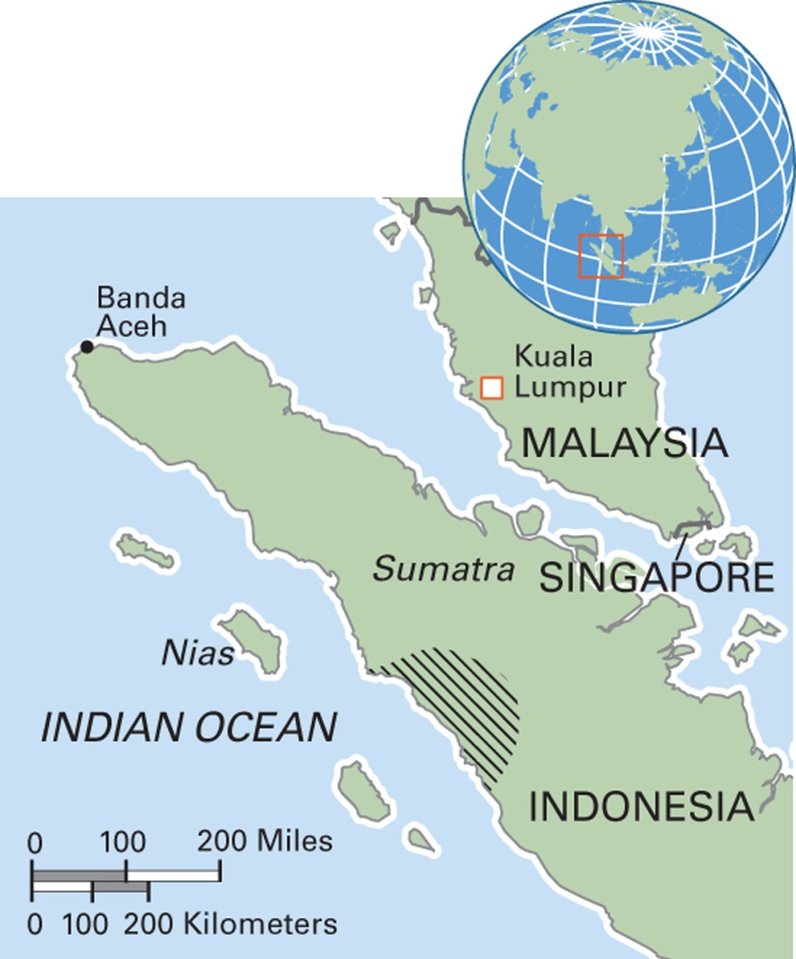
Map 8.3 Minangkabau Region in Indonesia
Notes:
The shaded area shows the traditional heartland of Minangkabau culture in western Sumatra. Many Minangkabau people live elsewhere in Sumatra and in neighboring Malaysia.

Slide 17
Sharing
Kinship through sharing
  Food sharing
  Godparenthood
  Adoption and fostering
    Example: child fostering in Ghana

Slide 18
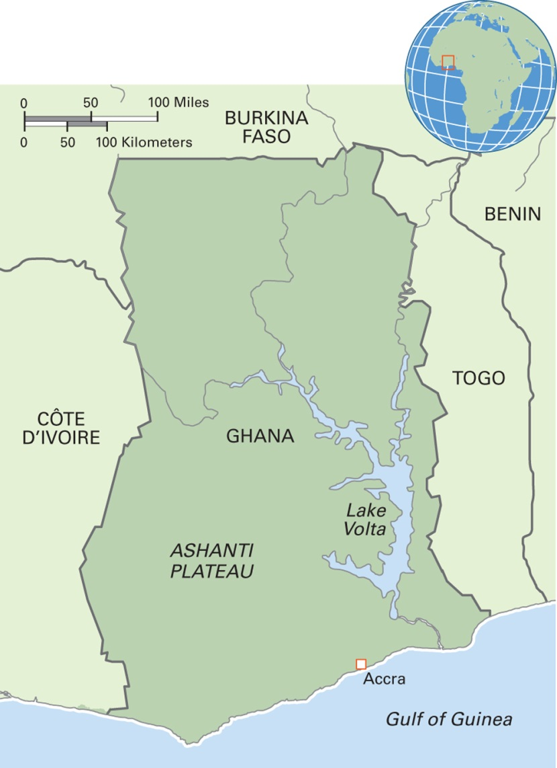
Map 8.5 Ghana
Notes:
The Republic of Ghana has over 25 million people. Ghana has rich natural resources and exports gold, timber, and cocoa. Agriculture is the basis of the domestic economy. Several ethnic groups exist, with the Akan people constituting over 40 percent of the population. English is the official language, but another 80 or so languages are also spoken. Over 60 percent of the people are Christian, 20 percent follow traditional religions, and 16 percent are Muslim.

Slide 19
Marriage (1 of 10)
What is marriage?
  Number of people involved
  Gender/sexual orientation of people involved
  Functions of the relationship—sexual intercourse, legitimacy of children, shared property, coresidence?

Slide 20
Marriage (2 of 10)
A comprehensive definition?
  Marriage is a more or less stable union, usually between two people, who may or may not be coresidential, sexually involved with each other, and procreative with each other

Slide 21
Marriage (3 of 10)
Rules for finding a marriage partner
  Rules of exclusion
  Preference rules
    Features such as age, height, looks, wealth, education
    Cousin marriage in some cultures
    Romantic love in some cultures
    Marriage gifts

Slide 22
Marriage (4 of 10)
Exclusion rule: the incest taboo
  All cultures have some form of incest taboo
  An incest taboo forbids sexual intercourse and/or marriage between certain kin
  Cultural variation in which kin are excluded
  Lévi-Strauss linked the incest taboo with the origin of exchange among humans

Slide 23
Marriage (5 of 10)
Cousin marriage
  Forbidden in some cultures
  Preferred in some cultures
  Various definitions of what is a cousin
  Various patterns of preference
    For cousins on one “side” of the family (mother’s or father’s)
    For cross-cousins or parallel cousins
    Example: South India

Slide 24
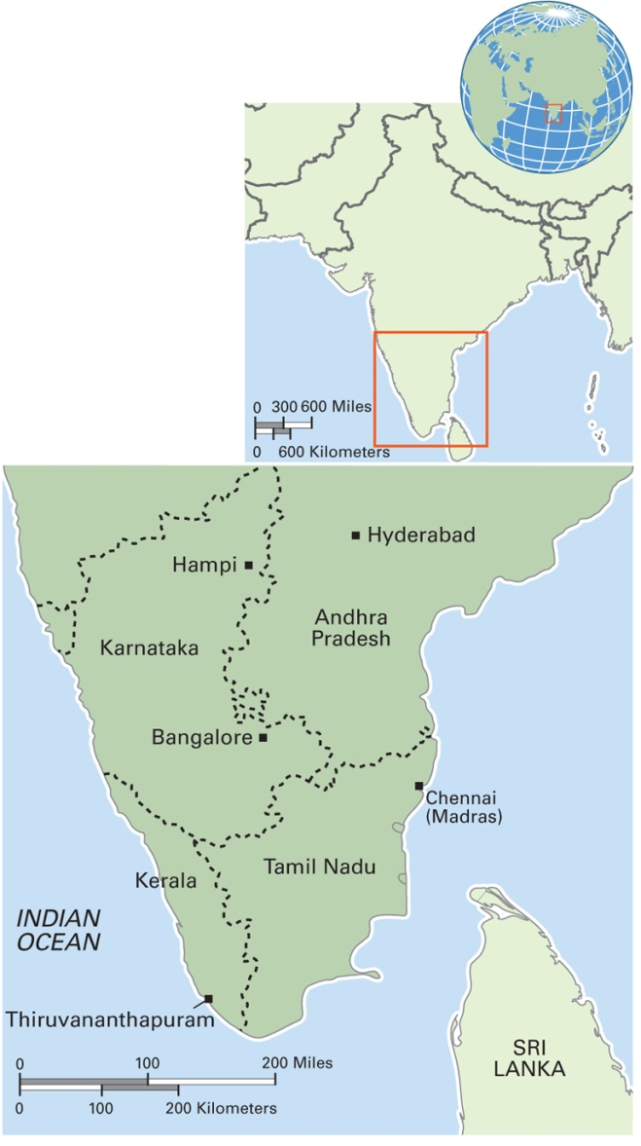
Map 8.4 South India
Notes:
The states of southern India, compared to the northern states, have lower population density, lower fertility rates, higher literacy rates, and less severe gender inequality. Agriculture is the mainstay of the region’s economy, and the population is predominantly rural. Industry, information technology, and business process outsourcing (BPO) are of rising importance in several cities in the region.

Slide 25
Marriage (6 of 10)
Endogamy and exogamy as preference rules
  Endogamy: marriage within a particular region or social category
  Exogamy: marriage outside a particular region or social category

Slide 26
Marriage (7 of 10)
Examples of preference rules
  Kinship
  Location
  Ethnicity
  Status/economic position
  Looks (beauty, height)
  Physical ability
  Romantic love

Slide 27
Marriage (8 of 10)
Status considerations in partner selection (heterosexual pairing)
  Hypergyny: the bride marries a groom of higher status
  Hypogyny: the bride marries a groom of lower status
  Isogamy: the bride and groom are status equals

Slide 28
Marriage (9 of 10)
Often involves a series of gift/monetary exchanges between the bride’s and groom’s families
  Dowry
  Groomprice
  Brideprice
  Brideservice
The wedding: ranges from very simple to highly elaborate and expensive
  Weddings “crystallize” and highlight cultural meanings of the marital relationship and gender roles

Slide 29
Marriage (10 of 10)
Forms of Marriage
  Monogamy: marriage between two people
  Polygamy: marriage between more than two people
    Polygyny: one man and more than one woman
    Polyandry: one woman and more than one man

Slide 30
Households and Domestic Life
8.2 Recognize how anthropologists define and study households and domestic life.
The Household: Variations on a Theme
Intrahousehold Dynamics

Slide 31
The Household: Variations on a Theme (1 of 5)
Family versus household
  A family is a group of people who consider themselves related by kinship
  A household is a person or persons who live together and may or may not be related by kinship
  Both terms are important in anthropology

Slide 32
The Household: Variations on a Theme (2 of 5)
Nuclear household
  Common worldwide but not always the preferred form in a given location
  Found among foragers and industrial/digital groups
  Common North American household type, though on the decline as the number of single-person households increases

Slide 33
The Household: Variations on a Theme (3 of 5)
Extended household
  More common among horticulturalists, pastoralists, and agriculturalists
  Related to fixed economic base/property
  May be extended vertically through parents and sons/daughters or horizontally through siblings
  Provides safety net for child care and old age support

Slide 34
The Household: Variations on a Theme (4 of 5)
Stem household
  Common in East Asia
  Household formation includes parents and one offspring, usually a son, and his spouse and children
  In some ways, a sub-type of extended family but limited to extension through just one descendant

Slide 35
The Household: Variations on a Theme (5 of 5)
Household headship
  Household head: primary person(s) responsible for supporting the household financially and making major decisions
  Model of male head: based on Euro-American, male-biased view
  Matrifocality: a household in which a woman is the central, stable domestic figure; common among lower-income people in the Caribbean, Central/South America, the United States

Slide 36
Intrahousehold Dynamics (1 of 2)
Spouse–partner relationships
  Case study: marital satisfaction in arranged versus love-match marriages in Tokyo, Japan
Sibling relationships
  Example: brother–sister relationship in Beirut, Lebanon
Households without a home

Slide 37
Intrahousehold Dynamics (2 of 2)
Domestic violence
  Found in most but not all cultures and in differing degrees:
    Child abuse
    Honor killings
    Wife/partner abuse: male violence against females
      More common where men control wealth/property and women are dependent on them

Slide 38
Anthropology Works: Preventing
Wife Abuse in Rural Kentucky
Highest rate of reported domestic violence in the United States
Ethnographic study revealed cultural factors
  Physical isolation
  Social isolation
  Institutional isolation
Food for Thought:
  Since the study was conducted, cell phone use has expanded worldwide. Will cell phones be likely to reduce women’s isolation in rural Kentucky?

Slide 39
Changing Kinship and Household Dynamics
8.3 Illustrate how households and kinship are changing.
Change in Descent
Change in Marriage
Changing Households

Slide 40
Change in Descent
Role of European colonialism
  Decline of matrilineal descent worldwide
Among the Minangkabau
  Dutch colonialism promoted male household headship
  Islamic teachings promote men as household heads and women as “wives”
  Indonesian state policy favors male household headship

Slide 41
Change in Marriage
Forms of courtship expanding with modern communications
Age at first marriage is rising
Marriage “crisis”
  Economic conditions make dowry or other exchange difficult
Wedding style
  Globalization of the Western “white wedding”
  Some counter trends toward “ethnic” or traditional styles
  Wedding style syncretism (blending of features)

Slide 42
Changing Households
Globalization of nuclear households
  Example: the Kelabit of Malaysia
Effects of international migration: the case of “Nadia”
Shrinking households in the United States
Multigenerational households and “boomerang kids” in the United States

Slide 43
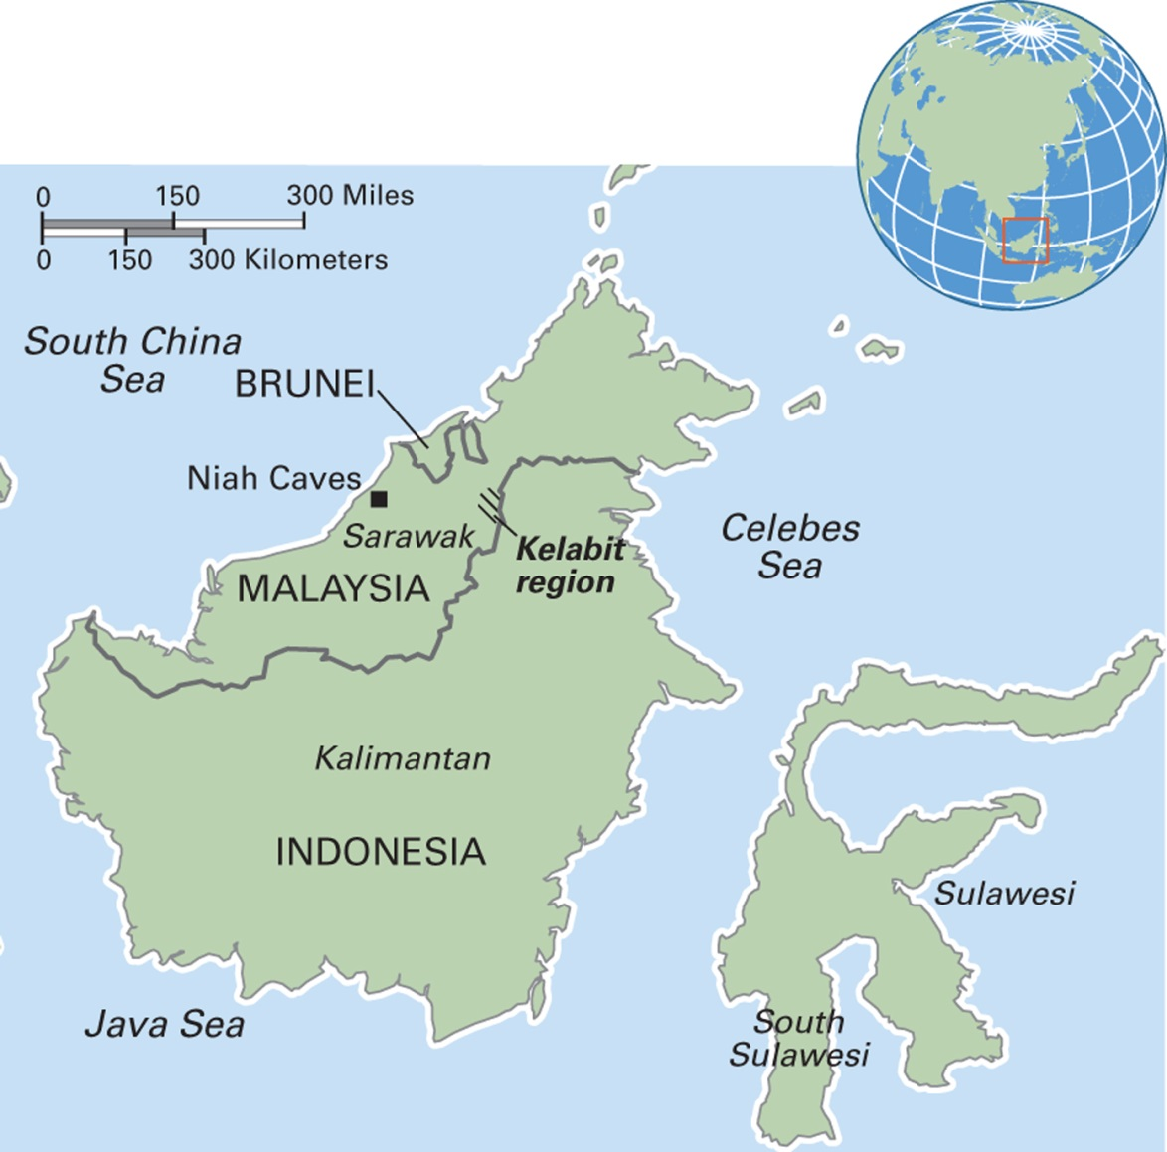
Map 8.7 Kelabit Region in Malaysia
Notes:
The Kelabit people’s homeland is the Kelabit Highlands in Sarawak, a plateau ringed by mountain peaks that are forest covered. One of Malaysia’s smallest indigenous tribes, they number around 6,000 people, or 0.4 percent of Sarawak’s population of 1.5 million, and 0.03 percent of Malaysia’s total population of 30 million. Less than one-third of the Kelabit people now live in the highlands.

